Slide 1
Parallel Implementation of the OpenGL Pipeline (A1)
Dr. Hamish Carr & Dr. Rafael Kuffner dos Anjos

Slide 2
Agenda
The projective Pipeline
Parallel implementation
Assignment 1
COMP 5812M: Foundations of Modelling & Rendering

Slide 3
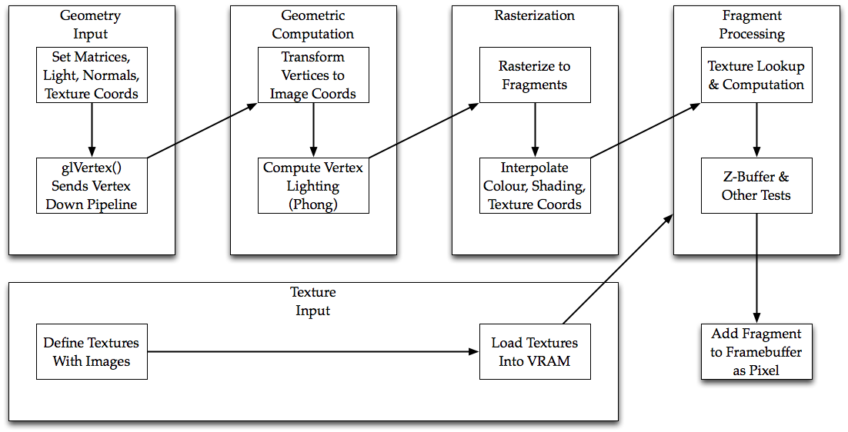
The Projective Pipeline

Slide 4
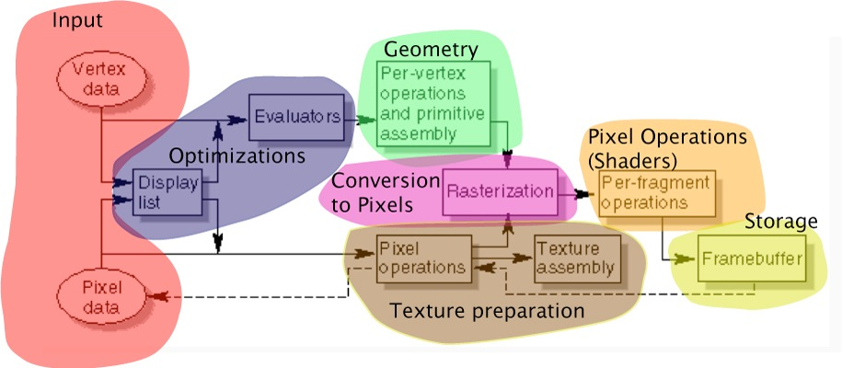

Fixed Function Pipeline
This is the original hardware design
Deeply pipelined, massively parallel
Now simulated by GP processors

Slide 5
Pipeline Stages
Input: Vertex(), Normal(), &c.
Transform: TransformVertex()
Raster: RasterisePrimitive()
Fragment: ProcessFragment()
Framebuffer: Clear()
Texture Prep: Texture()
State Changes: all the other functions
COMP 5812M: Foundations of Modelling & Rendering

Slide 6
States
Matrix State
Pipeline state is set by function calls
Define variables for each piece of state
Vertex State
Lighting State

Slide 7
Queues
Data processing is via queues
Stages read from one queue, write to another
Input stage does not read from a queue
Fragment stage writes directly to image
Input
Transform
Rasterise
Fragment
Output

Slide 8
Parallel Issues
When/how do we invoke stages?
What happens when we change state?
What does flushing the pipeline do?
How do we prevent collisions on queues?
How do we know when we are done?

Slide 9

When/how do we invoke stages?
A1 hint!
1- FakeGL::Vertex() trigger later stages
2- Have an EndFrame() routine trigger stages
3- Use a separate thread for each stage
4- Use multiple threads for each stage
Use multiple threads & queues for each stage

Slide 10

What happens when we change state?
How does it affect data on queues?
Retrospective?
Prospective?
- Single thread changes it immediately
- Multi thread flush the pipeline

Slide 11


What does flushing the pipeline do?
Stalls the input
Forces all data in queues to finish processing
Change the state & returns
Avoid it except end of frame!

Slide 12
When Do Flushes Occur?
Matrix change
Lighting change
Texture change
Change attributes
Yes!
No!
We could change parameters into attributes, but it would drive up bandwidth.

Slide 13

How do we prevent collisions on queues?
Standard parallel problem: read/write conflict
Avoid with a locking mechanism: E.g. std::lock_guard
Lock the queue while reading or writing!
COMP 5812M: Foundations of Modelling & Rendering

Slide 14
Queue Access
Lock input queue
Retrieve data from queue
Unlock input queue
Process data
Then lock, write & unlock output queue
EXPENSIVE!
COMP 5812M: Foundations of Modelling & Rendering

Slide 15
Parallel Queue Access
32 processors
Lock the queue once
All 32 processors read one packet each
Unlock the queue once
SIMD/SMP parallelism
Not thread-style parallelism
And this is what warps do in hardware
COMP 5812M: Foundations of Modelling & Rendering

Slide 16
Std::deque Problem
std::deque automatically resizes
Stalls memory management
Standard solution: fixed (large) queue
Input stalls if it's already full
Until another thread starts clearing it
COMP 5812M: Foundations of Modelling & Rendering

Slide 17

How do we know when we are done?
There is usually a Flush() call at the end
Or a SwapBuffers() which calls flush
In Qt & similar, this is called automatically
The simple solution doesn't need to: single threaded!

Slide 18
Assignment 1
Implement the simple solution
Single thread of control
At end of Vertex(), call
TransformVertex()
RasterisePrimitive()
ProcessFragment()
Framebuffer is a simple image
COMP 5812M: Foundations of Modelling & Rendering

Slide 19
Framebuffer
Real hardware can lock per pixel
Or finesses it so it doesn't need to
Doing this in software is expensive
So we won't even try
Just write directly to the framebuffer image
And don't worry about locking

Slide 20
Approach
1. Take a sample programme
2. Make a list of all the functions called
3. Analyse variables
4. Write debug code
5. Design decision: threads & stages
6. Implementation Plan
7. Implementation

Slide 21
Sample Programme
OpenGL
FakeGL

Slide 22
Support Code
Cartesian3 3D Cartesian coordinates
Homogeneous4 Homogeneous coordinates
Matrix4 Homogeneous matrices
Quaternion Quaternions
RGBAValue Colour values (bytes)
RGBAImage Simple image class (.ppm)
TexturedObject Object class (.obj/.ppm)

Slide 23
TexturedObject
The core of our Model
Texture & geometry specified separately
Otherwise, reads in a subset of .obj file
Has two nearly identical render routines
TexturedObject::Render()
TexturedObject::FakeGLRender()
COMP 5812M: Foundations of Modelling & Rendering

Slide 24
UI Classes
RenderParameters Model class
RenderWidget View class
RenderController Controller class
RenderWindow Window class
ArcBall/ArcBallWidget ArcBall widget
FakeGLRenderWidget Your widget

Slide 25
FakeGLRenderWidget
FakeGLRenderWidget
paintGL() paints image in widget
calls paintFakeGL() to paint image
paintFakeGL() has modified OpenGL calls
based on RenderWidget::paintGL()
calls TexturedObject::FakeGLRender()
changes here will be minimal
COMP 5812M: Foundations of Modelling & Rendering

Slide 26
FakeGL.h/.cpp
Based on a FakeGL context
a data structure storing all library state
three ancillary classes (later)
skeleton functions to implement
partial code for RasteriseTriangle()
Your code goes here!
COMP 5812M: Foundations of Modelling & Rendering

Slide 27
Recommended Approach
Decide on state variables & attributes
Implement stream output functions
Implement Clear()
Implement TransformVertex()
Implement RasterisePoint()
Implement ProcessFragment()
Implement PointSize()

Slide 28
Recommended Approach
Add matrix transformations
Implement Depth Test
Implement RasteriseLineSegment()
Add calls for RasteriseTriangle()
Implement Lighting in TransformVertex()
Implement Textures
Implement Phong shading

Slide 29

Deciding on state variables & attributes
It’s hard to know what you need, until you need it!
Do this before starting each implementation step.
Tips:
Look at how the methods are used on FakeGLRenderWidget/RenderWidget
Look at defined constants on FakeGL.h
COMP 5812M: Foundations of Modelling & Rendering

Slide 30
Output stream functions
After you have variables, implement printing them out.
Useful for debug when you cannot see things on the screen
Std::cout << fakeGL << std::endl; whenever you want to check the state.
getchar() stalls so you can read output if you want

Slide 31
Clear()
Sets every pixel in the frame buffer
Just implement setting pixel to colour
Tests whether we are showing frame buffer
COMP 5812M: Foundations of Modelling & Rendering

Slide 32
TransformVertex()
Reads vertex from vertexQueue
Converts it to VCS
Then computes lighting (if enabled)
Then finishes conversion to DCS (why?)
Sets position, colour, tex coords
And adds vertex to rasterQueue
Start with what you have (color) add the rest later.

Slide 33
RasterisePrimitive()
Slightly tricky – depends on primitive type
points, lines or triangles
one subroutine for each
Return false if queue is empty
Or if it doesn't have enough vertices
For now, assume that calls are balanced

Slide 34
RasterisePoint()
Only sets one pixel – hard to see
But not impossible
Render a small number of points
And use the text output to debug it
Hence the exercise the first week
Then upgrade to add a set of fragments
in a box based on PointSize()

Slide 35
ProcessFragment()
Simplest version always sets the pixel
Based on the row & col retrieved from queue
So implement that first
Then add extra features one at a time

Slide 36
Depth test
Now you are able to see points, and has gone through all the pipeline.
Go through the implemented functions adding the variables/tests to implement the depth test.
We will use an extra image as depth buffer
Store the depth in the alpha channel.
COMP 5812M: Foundations of Modelling & Rendering

Slide 37
RasteriseLineSegment()
Start by calling RasterisePoint() twice
Then add line raster code:
Parametric
setting pixels directly
or calling RasterisePoint() repeatedly
Quad (needs triangle working first)

Slide 38
RasteriseTriangle()
M.Eng. students did this last year
M.Sc. students did not
Don't want unfair advantage or boredom
So I'm providing code for it
But only for colour interpolation
You will need to modify it a little bit for other functions

Slide 39
Lighting/textures
Add necessary states/management/variables
Modify implemented functions to add one feature at a time.
If output starts to stall, use a simpler model.
COMP 5812M: Foundations of Modelling & Rendering

Slide 40
More on lab later today!

